Slide 1
Paper Review
Responding to News Sensitively in Stock Attention Networks via Prompt-Adaptive Trimodal Model
Haotian Liu, Bowen Hu , Yadong Zhou and Yuxun Zhou
IEEE TRANSACTIONS ON NEURAL NETWORKS AND LEARNING SYSTEMS, VOL 36, NO. 6, JUNE 2025

Slide 2
Outline
Introduction
Related Work
Problem Statement
PA_TMM Architecture
Model Optimization
Experiments
Conclusion

Slide 3
Introduction
Backgrounds and Challenges
Rapid Growth
of Multimedia Platforms
Limitations of
Existing Models
Two Main Challenges
Financial news & social media provide crucial investment signals
Stock prices contain randomness (random walk)
But, there is deterministic components driven by news
Time-series Forecasting Model - Stocks are mutually exclusive ➡️ Ignore inter-stock dynamics like Momentum spillover
GNN Model: - Hard-coded microstructure ➡️ Capture limited interactions
GATs Model - Dynamically assign weights ➡️ Biased attention effect ← Massive price-related features
Real-world: a fraction of stocks have the news
Long Tail Effect in Feature Distribution - Distracted by abundant time-series data - Breaking news receive insufficient attention ➡️ Biased attention toward price related information
Data Scarcity Problem ➡️ Poor generalization
Notes:
- multivariate time-series features
- opening price, closing price, and volume
- discrete tabular features
- technical indicators calculated based on historical trading signals
- 가격·거래량 등 시계열 데이터를 기반으로 일정한 계산식(공식)을 적용하여 도출된 숫자형 요약 지표들
- MA (이동평균선): 일정 기간 동안의 평균 가격. 상승/하락 추세 식별
- MACD: 장·단기 이동 평균선 간 차이를 통해 추세 전환 포착
- 왜 "이산형(discrete)"일까?
- 하루 단위, 혹은 특정 윈도우(5일, 14일, 30일 등)를 기준으로 하나의 고정된 수치 값을 출력
- 연속적인 시계열이 아닌, 고정된 시점에서의 하나의 값으로써 **이산적(discrete)
모든 주식은 서로 독립적이라는 가정하에 서로 간의 상호작용을 무시(Assume all stocks are mutually exclusive)
- Why? momentum spillover effect(모멘텀 전이 효과)
- factor movement:주식 수익률에 영향을 주는 공통 요인(Market factor, Value, Growth, Small/Big, Momentum)이 변하면서 개별 주식 또는 여러 섹터에 영향을 미침
- lead-lag effect: 한 자산(또는 지표)의 가격 움직임이 시간적으로 선행(lead)하고, 다른 자산이 뒤따라서 반응(lag)하는 현상
- t: 기술주 ETF 급등 ➡️ t+1: 삼성전자 상승
- portfolio rebalancing: ETF나 기관 포트폴리오의 리밸런싱 ➡️ 포함된 여러 종목에 동시적으로 매수 또는 매도 압력
- 현실에서는 주식 간 다음과 같은 상관관계(correlation) 또는 **영향 전이(spillover)**가 존재
- 삼성전자 주가 상승 → SK하이닉스 주가도 반응
- 테슬라 실적 발표 → LG에너지솔루션 영향

Slide 4
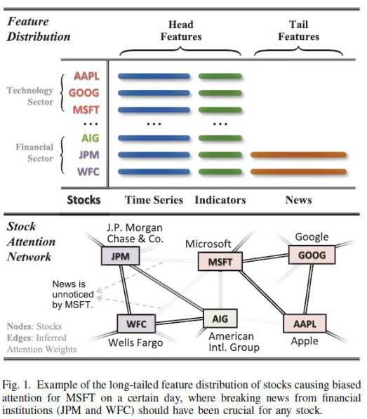
Introduction
Backgrounds and Challenges
Top
Time-series features and Technical indicators ➡️ All stocks
News ➡️ Few stocks: JPM, WFC
Bottom
JPM, WFC: Breaking news that impact the overall stock market
Other sectors: News is unnoticed
p. 2

Slide 5
Introduction
Solution
Turning Point : Near-equivalence
Prompt-Adaptive Trimodal Model (PA-TMM)
Contributions
Idiosyncratic Nature of Financial News → Breaking news of specific stocks has Instantaneous dominance over their movements
Example: 2024.01, the Federal Aviation Administration ordered airlines to ground more than 170 Boeing 737 aircraft → Boeing's stock: Drop 8% → Airbus’s stock: Slight increase - Boeing's primary competitor:
Cross-Modal Fusion Module : Trimodal features ➡️ Sentiments Prompts
Graph Dual-Attention Module ➡️ Stock Attention Network (dynamic interaction)
Movement Prompt Adaptation : Equivalence Resampling ➡️ Movement Prompt
Pretraining, Fine-tuning : Adapt to feature Imbalance → Focus on real news
Incorporate the dominance of news and capture news propagation dynamics by GATs
Pretraining with MPA: Sensitively respond to tailed news and avoid over-reliance on stocks carrying news
Equivalence Resampling Strategy (Data Augmentation) : Tackle data scarcity problem and enhance generalizability
Notes:
`

Slide 6
Related Work
Time-Series Stock Prediction
Graph-Based Stock Prediction
News-Based Stock Prediction
Encode the time series pattern by using RNN based models - PEN [40], MAN-SF [12], and MTR-C [41]
Mingle market factors [42], investment behaviors [43], technical indicators - REST [44], Digger-Guider [45]
Limitation of underlying assumption - Stocks are mutually exclusive
Conceptualize the stock market as a graph - Capture peer influences by using Graph Neural Networks - Node (each stock), Edges (relations)
THGNN [3], ESTIMATE [2], SAMBA [49]
Limitation - Relations are modeled by the static network
Integrate external information beyond the trading market - Financial news, Social media posts
Graph Convolutional Networks - MAC [1], NumHTML [52], MFN [53]
Graph Attention Networks - AD-GAT [15], DANSMP [6]
Multi-Modal: MSMF [54]
Limitation - Lack of consideration for the long-tail effect
Notes:
(market factors [42]: moving average convergence/divergence (MACD), price-tobook ratio (P/B), relative strength index (RSI))
(investment behaviors [43]: 사람들의 집합적 투자 행동에서 추출된 주식 속성이 주가 예측 과제에서 높은 효과성을 갖고 있음)

Slide 7
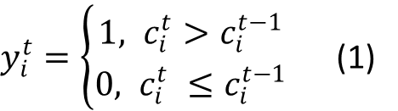
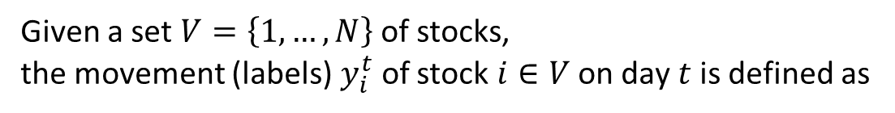
Problem Statement
Classification Method for Optimization
1
In the stock market, predicting the exact value of stock prices is far more challenging than predicting price movements
Classify stock as rising or falling: Compare current and previous day stock prices
Given a set $V=\left\{1,…,N\right\}$ of stocks,
the movement (labels) $y_{i}^{t}$ of stock $i∈V$ on day $t$ is defined as
$y_{i}^{t}=\left\{\begin{aligned}1, c_{i}^{t}>c_{i}^{t−1} \\ 0, c_{i}^{t} ≤c_{i}^{t−1}\end{aligned}\right.$ (1)

Slide 8
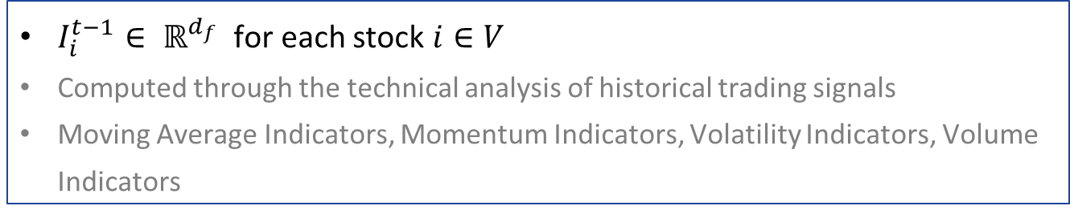
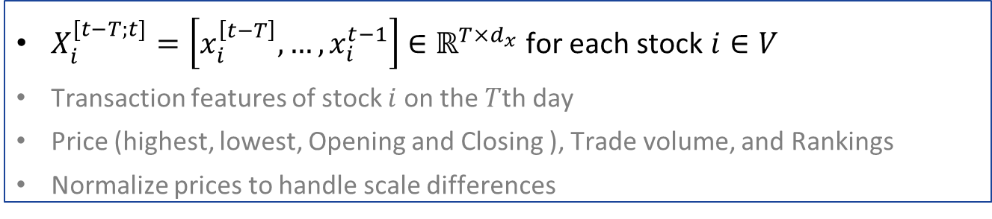
Problem Statement
Three Feature Modalities
2
Input features on the $(T−1)$th day ➔ Predict the movements on the $T$th day
Textual News Copora Ƭ
Labeled the relevant stocks impacted by each news item
Historical
Time-Series Trading Signals
$X_{i}^{[t−T;t]}=\left[x_{i}^{\left[t−T\right]},…,x_{i}^{t−1}\right]$ $∈ℝ^{T×d_{x}}$ for each stock $i∈V$
Transaction features of stock $i$ on the $T$th day
Price (highest, lowest, Opening and Closing ), Trade volume, and Rankings
Normalize prices to handle scale differences
Tabular Technical Indicators
$I_{i}^{t−1}∈ ℝ^{d_{f}}$for each stock $i∈V$
Computed through the technical analysis of historical trading signals
Moving Average Indicators, Momentum Indicators, Volatility Indicators, Volume Indicators

Slide 9
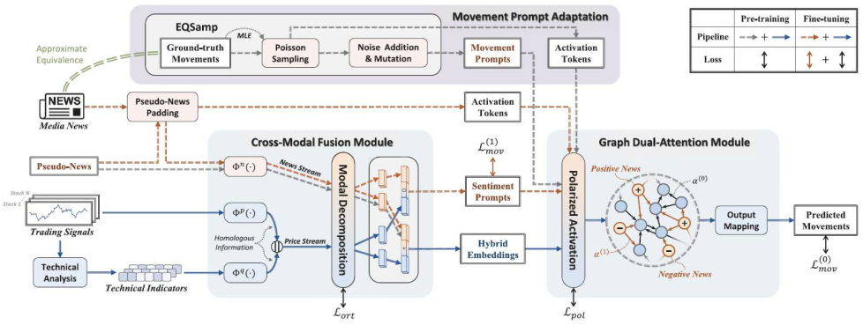

Prompt-Adaptive Trimodal Model Architecture
Two Subnetworks: Cross-Modal Fusion Module, Graph Dual-Attention Module
Movement Prompt Adaptation → Pretraining ➡️ Fine-tuning
p. 4

Slide 10
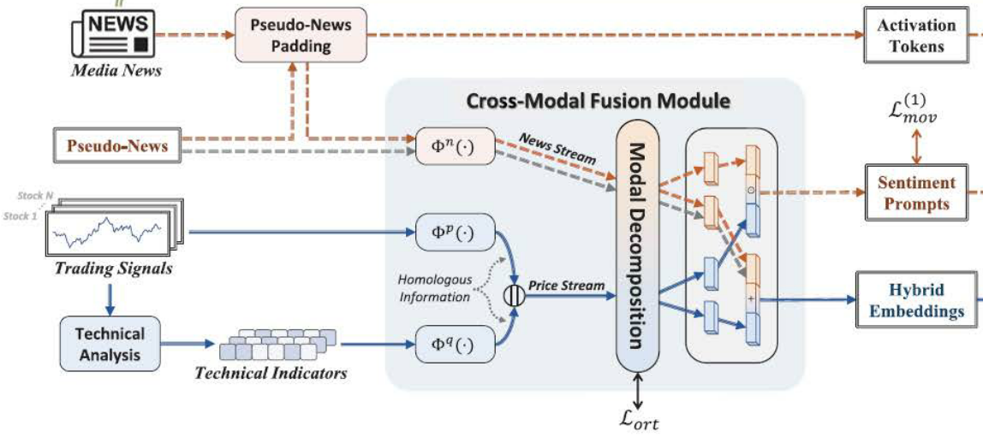
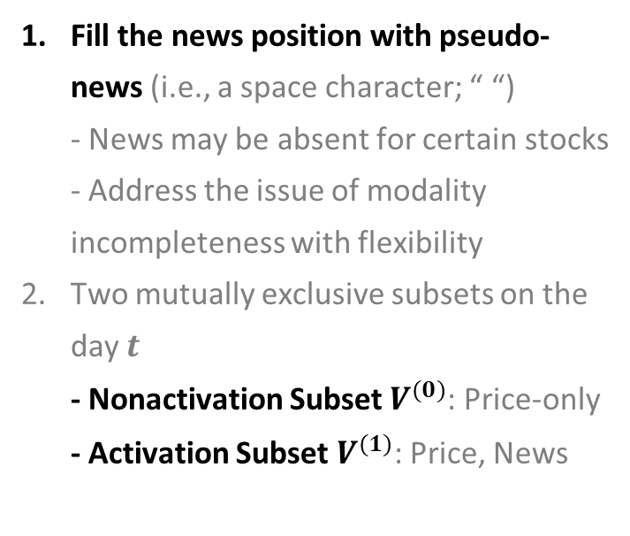
PA-TMM Architecture
Cross-Modal Fusion Module
Pseudo-News Padding and Activation State
1
Fill the news position with pseudo-news (i.e., a space character; “ “) - News may be absent for certain stocks - Address the issue of modality incompleteness with flexibility
Two mutually exclusive subsets on the day $t$ - Nonactivation Subset $V^{(0)}$: Price-only - Activation Subset $V^{(1)}$: Price, News

Slide 11
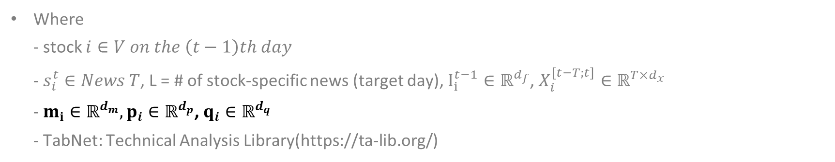
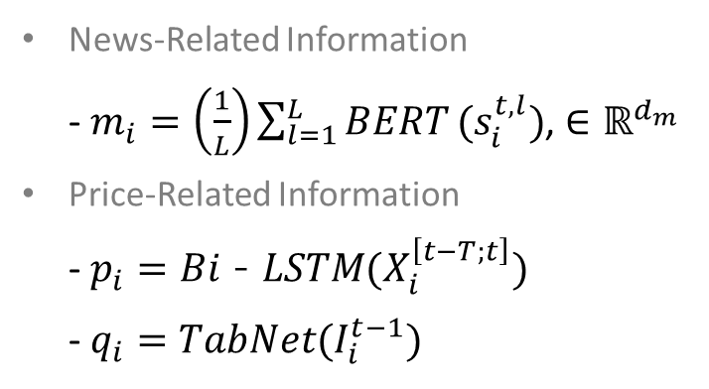
PA-TMM Architecture
Cross-Modal Fusion Module
Representation Learning
2
News-Related Information - $m_{i}=\left(\frac{1}{L}\right)\sum_{l=1}^{L}{BERT}(s_{i}^{t,l})$, $∈ℝ^{d_{m}}$
Price-Related Information - $p_{i}=Bi\text{－}LSTM(X_{i}^{\left[t−T;t\right]})$ - $q_{i}=TabNet(I_{i}^{t−1})$
Where - stock $i∈V on the \left(t−1\right)th day$ - $s_{i}^{t}∈News T$, L = # of stock-specific news (target day), $I_{i}^{t−1}∈ℝ^{d_{f}}$, $X_{i}^{\left[t−T;t\right]}∈ℝ^{T×d_{x}}$ - $m_{i}∈ℝ^{d_{m}},p_{i}∈ℝ^{d_{p}}$, $q_{i}∈ℝ^{d_{q}}$ - TabNet: Technical Analysis Library(https://ta-lib.org/)

Slide 12
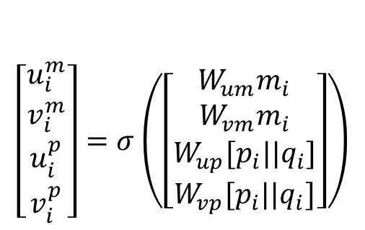
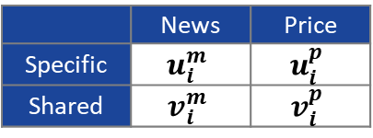
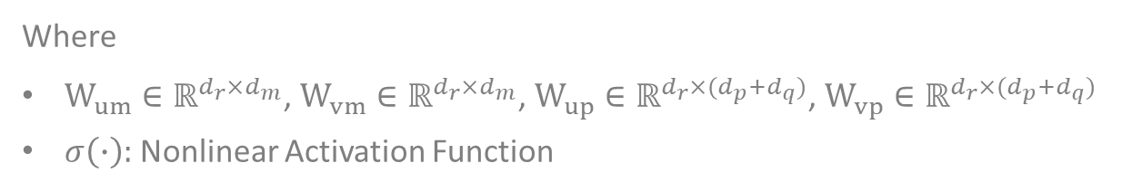
PA-TMM Architecture
Cross-Modal Fusion Module
Modal Decomposition
3
Project trimodal representations into 4 different spaces
 | News | Price
Specific | $$u_{i}^{m}$$ | $$u_{i}^{p}$$
Shared | $$v_{i}^{m}$$ | $$v_{i}^{p}$$
$$\left[\begin{aligned}u_{i}^{m} \\ v_{i}^{m} \\ u_{i}^{p} \\ v_{i}^{p}\end{aligned}\right]=σ\left(\left[\begin{aligned}W_{um}m_{i} \\ W_{vm}m_{i} \\ W_{up}{[p}_{i}||q_{i}] \\ W_{vp}{[p}_{i}||q_{i}]\end{aligned}\right]\right)$$
Where
$W_{um}∈ℝ^{d_{r}×d_{m}}$, $W_{vm}∈ℝ^{d_{r}×d_{m}}$, $W_{up}∈ℝ^{d_{r}×{(d}_{p}+d_{q})}$, $W_{vp}∈ℝ^{d_{r}×{(d}_{p}+d_{q})}$
$σ\left(∙\right):$Nonlinear Activation Function
Orthogonal Loss: Ensure the independence of the modal-specific spaces from the modal-shared spaces - $L_{ort}={{∥W}_{um}⋅W_{vm}^{T}∥}_{F}+{∥W_{up}⋅W_{vp}^{T}∥}_{F}$ , where $∥ ∥_{F}:$Frobenius Norm $=\sqrt{∑∑{\left|x_{ij}\right|}^{2}}$
Notes:
F 가 뭔지??

Slide 13

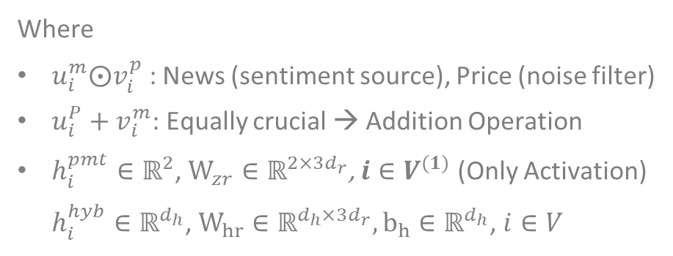
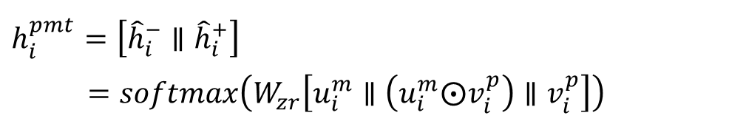
PA-TMM Architecture
Cross-Modal Fusion Module
Modal Integration
4
Media sentiment → Impact stock prices
News-Stream Integration ➡️ Sentiment Prompts
$$h_{i}^{pmt}=\left[{\hat{h}}_{i}^{−}∥{\hat{h}}_{i}^{+}\right]$$
$=softmax\left(W_{zr}\left[u_{i}^{m}∥\left(u_{i}^{m}⨀v_{i}^{p}\right)∥v_{i}^{p}\right]\right)$
Price-Stream Integration ➡️ Hybrid Embeddings
Where
$u_{i}^{m}⨀v_{i}^{p}$ : News (sentiment source), Price (noise filter)
$u_{i}^{P}+v_{i}^{m}$: Equally crucial → Addition Operation
$h_{i}^{pmt}∈ℝ^{2}$, $W_{zr}∈ℝ^{2×{3d}_{r}}$, $i∈V^{(1)}$ (Only Activation) $h_{i}^{hyb}∈ℝ^{d_{h}}$, $W_{hr}∈ℝ^{d_{h}×{3d}_{r}}, b_{h}∈ℝ^{d_{h}}$, $i∈V$
$$h_{i}^{hyb}=σ\left(W_{hr}\left[u_{i}^{p}∥\left(u_{i}^{p}+v_{i}^{m}\right)∥v_{i}^{m}\right]+b_{h}\right)$$

Slide 14
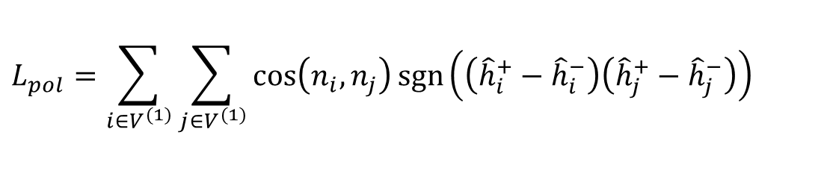
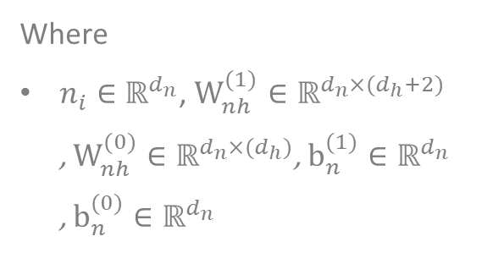
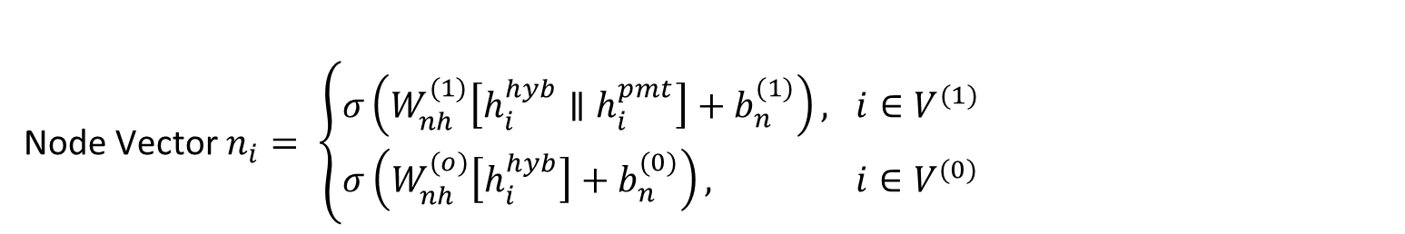
PA-TMM Architecture
Graph Dual-Attention Module
Stock Polarized Activation
1
Activated stocks carry more dominant information ➡️ Asymmetric feature distribution
Different activation states → Varying inter-stock influences ➡️ Separate embedding
Node Vector $n_{i}= \left\{\begin{aligned}σ\left(W_{nh}^{(1)}\left[h_{i}^{hyb}∥h_{i}^{pmt}\right]+b_{n}^{(1)}\right), i∈V^{(1)} \\ σ\left(W_{nh}^{(o)}\left[h_{i}^{hyb}\right]+b_{n}^{(0)}\right), i∈V^{(0)}\end{aligned}\right.$
Where
$n_{i}∈$ $ℝ^{d_{n}}$, $W_{nh}^{(1)}∈ℝ^{d_{n}×{(d}_{h}+2)}$ , $W_{nh}^{(0)}∈ℝ^{d_{n}×{(d}_{h})}$, $b_{n}^{(1)}∈ℝ^{d_{n}}$ , $b_{n}^{(0)}∈ℝ^{d_{n}}$
Polarization loss (via cosine distance) “Opposing ➡️ Separated, Similar ➡️ Closer”
$$L_{pol}=\sum_{i∈V^{(1)}}{\sum_{j∈V^{(1)}}{\cos\left(n_{i}, n_{j}\right)\operatorname{sgn}\left(\left({\hat{h}}_{i}^{+}−{\hat{h}}_{i}^{−}\right)\left({\hat{h}}_{j}^{+}−{\hat{h}}_{j}^{−}\right)\right)}}$$

Slide 15
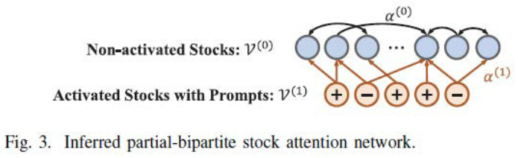
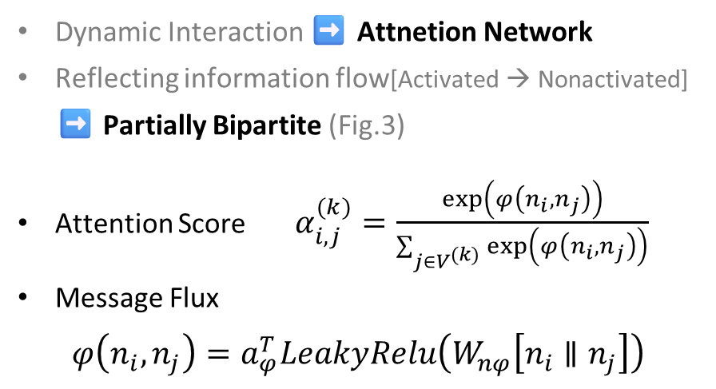
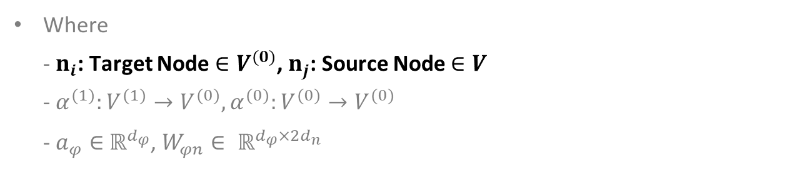
PA-TMM Architecture
Graph Dual-Attention Module
Interaction Inference
2
Dynamic Interaction ➡️ Attnetion Network
Reflecting information flow[Activated → Nonactivated] ➡️ Partially Bipartite (Fig.3)
Attention Score $α_{i,j}^{(k)}=\frac{\exp\left(φ\left(n_{i}, n_{j}\right)\right)}{\sum_{j∈V^{(k)}}{\exp\left(φ\left(n_{i}, n_{j}\right)\right)}}$
Message Flux $φ\left(n_{i}, n_{j}\right)=a_{φ}^{T}LeakyRelu\left(W_{nφ}\left[n_{i}∥n_{j}\right]\right)$
Where - $n_{i}$: Target Node $∈V^{(0)}$, $n_{j}$: Source Node $∈V$ - $α^{(1)}:V^{(1)}→V^{(0)},α^{(0)}:V^{(0)}→V^{(0)}$ - $a_{φ}∈$ $ℝ^{d_{φ}}$, $W_{φn}∈ ℝ^{d_{φ}×2d_{n}}$

Slide 16
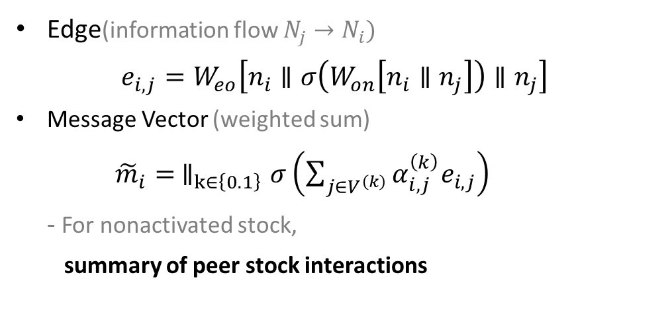
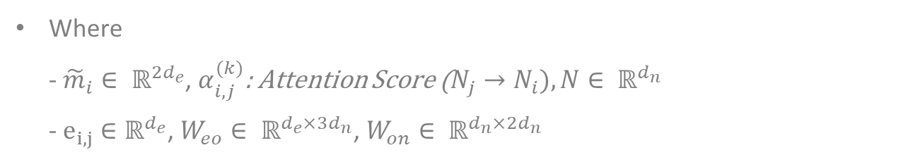
PA-TMM Architecture
Graph Dual-Attention Module
Information Exchange
3
Edge(information flow $N_{j}→N_{i})$ $e_{i,j}=W_{eo}\left[n_{i}∥σ\left(W_{on}\left[n_{i}∥n_{j}\right]\right)∥n_{j}\right]$
Message Vector (weighted sum) ${\tilde{m}}_{i}=$ $∥_{k∈\left\{0.1\right\}}σ\left(\sum_{j∈V^{\left(k\right)}}{α_{i,j}^{\left(k\right)}e_{i,j}}\right)$ - For nonactivated stock, summary of peer stock interactions
Where - ${\tilde{m}}_{i}∈ ℝ^{2d_{e}}$, $α_{i,j}^{(k)}$: Attention Score ($N_{j}→N_{i}), N∈ ℝ^{d_{n}}$ - $e_{i,j}∈ℝ^{d_{e}}$, $W_{eo}∈ ℝ^{d_{e}×3d_{n}}$, $W_{on}∈ ℝ^{d_{n}×2d_{n}}$

Slide 17
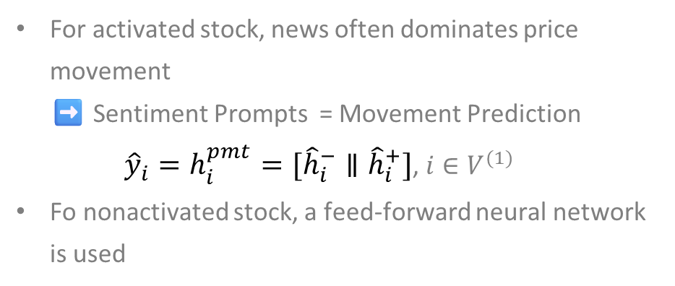
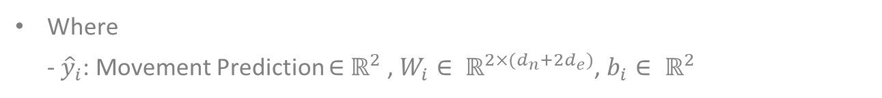
PA-TMM Architecture
Graph Dual-Attention Module
Output Mapping
4
For activated stock, news often dominates price movement ➡️ Sentiment Prompts = Movement Prediction ${\hat{y}}_{i}=h_{i}^{pmt}=[{\hat{h}}_{i}^{−}∥{\hat{h}}_{i}^{+}]$, $i∈V^{(1)}$
Fo nonactivated stock, a feed-forward neural network is used
${\hat{y}}_{i}=\left[{\hat{y}}_{i}^{−}∥{\hat{y}}_{i}^{+}\right]=softmax(W_{i}\left[n_{i}∥{\tilde{m}}_{i}\right]+b_{i})$, $i∈V^{(0)}$
Where - ${\hat{y}}_{i}$: Movement Prediction $∈$ $ℝ^{2}$ , $W_{i}∈ ℝ^{2×(d_{n}+2d_{e})}$, $b_{i}∈ ℝ^{2}$

Slide 18
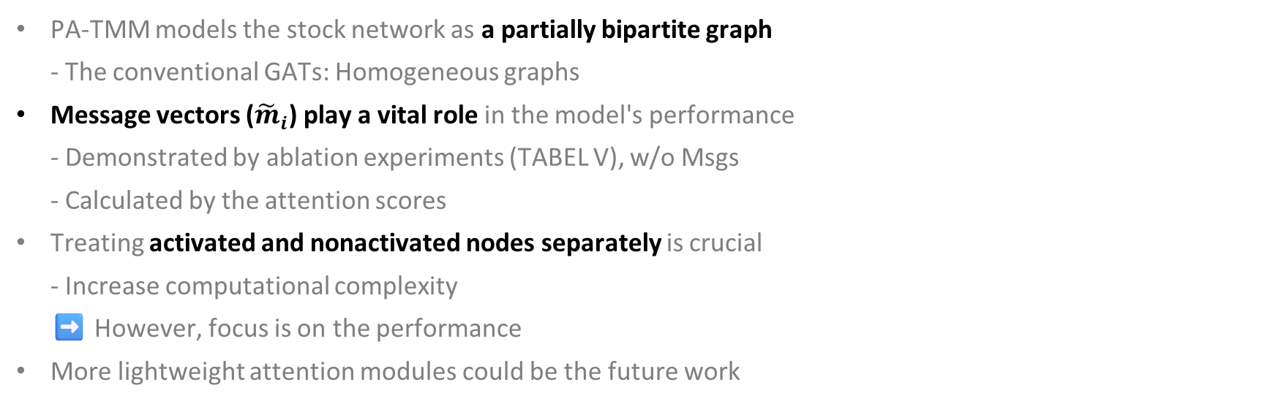
PA-TMM Architecture
Graph Dual-Attention Module
Discussion
5
PA-TMM models the stock network as a partially bipartite graph - The conventional GATs: Homogeneous graphs
Message vectors (${\tilde{m}}_{i}$) play a vital role in the model's performance - Demonstrated by ablation experiments (TABEL V), w/o Msgs - Calculated by the attention scores
Treating activated and nonactivated nodes separately is crucial - Increase computational complexity ➡️ However, focus is on the performance
More lightweight attention modules could be the future work

Slide 19
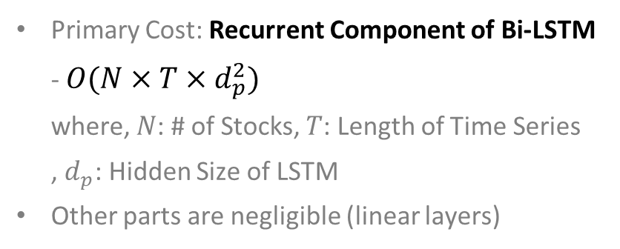
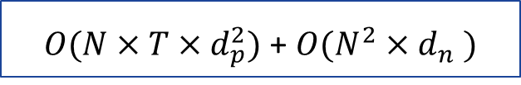
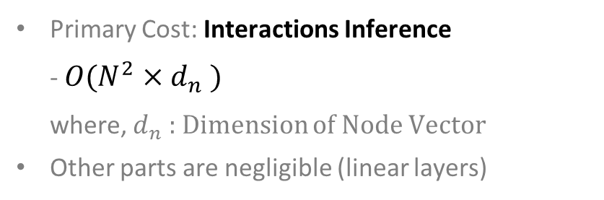
PA-TMM Architecture
Computational Complexity
Cross-Modal Fusion Module
Graph Dual-Attention Module
Primary Cost: Recurrent Component of Bi-LSTM - $O(N×T×d_{p}^{2})$ where, $N$: # of Stocks, $T$: Length of Time Series , $d_{p}$: Hidden Size of LSTM
Other parts are negligible (linear layers)
Primary Cost: Interactions Inference - $O(N^{2}×d_{n}^{})$ where, $d_{n}^{}$: Dimension of Node Vector
Other parts are negligible (linear layers)
Overall Complexity
$O(N×T×d_{p}^{2})$ + $O(N^{2}×d_{n}^{})$
Training Cost (hrs) : 4.7 for NASDAQ100, 7.9 for S&P500
Test Cost (sec) : 0.11 for NASDAQ100, 0.32 for S&P500

Slide 20
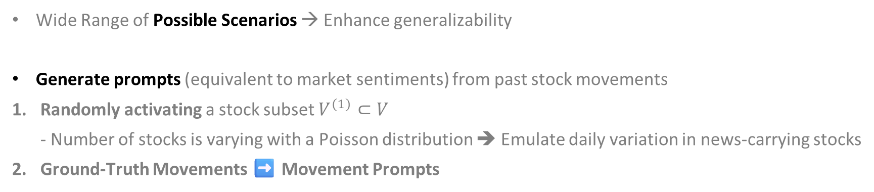
Model Optimization
Movement Prompt Adaptation : Equivalence Resampling
Data Augmentation Strategy → Tackle long tail effect in feature distribution
Wide Range of Possible Scenarios → Enhance generalizability
Generate prompts (equivalent to market sentiments) from past stock movements
Randomly activating a stock subset $V^{(1)}⊂V$ - Number of stocks is varying with a Poisson distribution ➔ Emulate daily variation in news-carrying stocks
Ground-Truth Movements ➡️ Movement Prompts
$h_{i}^{pmt}=\left[{\hat{h}}_{i}^{−}∥{\hat{h}}_{i}^{+}\right]=\left\{\begin{aligned}\left[\left(1−ε_{i}\right)∥ε_{i}\right], when y_{i}^{t}=0 (Down) \\ \left[ε_{i}∥\left(1−ε_{i}\right)\right], when y_{i}^{t}=1 \left(Up\right) \end{aligned}\right.$
where, $ε_{i} \sim U(0, 0.5)$
Randomness to Prompts for Robustness
Inverting Movement Prompts: $h_{i}^{pmt}←1−h_{i}^{pmt}$, with Mutation Probability $θ$ ➡️ By Injecting data noise, prevent the model from over-fitting

Slide 21

Model Optimization
Pretraining Objectives
$L_{mov}^{(0)}=−\frac{1}{\left|V\right|}\left(\sum_{i∈V^{\left(0\right)}}{\left(\left(1−y_{i}^{t}\right)\log\left({\hat{y}}_{i}^{−}\right)+y_{i}^{t}\log\left({\hat{y}}_{i}^{+}\right)\right)}\right)$ ➡️ $L_{p}=\sum_{t}{\left(L_{mov}^{(0)}+βL_{ort}+γL_{pol}\right)}$
Where, $β$ and $γ$ are the weighting factors

Slide 22

Model Optimization
Fine-Tuning Objectives
$L_{mov}^{(1)}=−\frac{1}{\left|V\right|}\left(\sum_{i∈V^{\left(1\right)}}{\left(\left(1−y_{i}^{t}\right)\log\left({\hat{h}}_{i}^{−}\right)+y_{i}^{t}\log\left({\hat{h}}_{i}^{+}\right)\right)}\right)$ ➡️ $L_{F}=\sum_{t}{\left(L_{mov}^{(1)}+L_{mov}^{(0)}+βL_{ort}+γL_{pol}\right)}$
Where, $β$ and $γ$ are the weighting factors

Slide 23
Experiments
Evaluation Setup
Datasets
1
Historical Trading Data
Technical Indicators
Table1 | NASDAQ 100 | S&P 500
# Stocks (Nodes) | 118 | 510
# Stocks with news (Average activated nodes) | 11 | 26
Pre-training period | Jan. 2014 - Dec. 2015 | Jan. 2014 - Dec. 2015
Fine-tuning and validation period | Jan. 2016 - Dec. 2018 | Jan. 2016 - Dec. 2018
Test period (12 tests in total) | Jan. 2019 - Dec. 2019 | Jan. 2019 - Dec. 2019
Using TA-lib (Technical Analysis Library)
e.g., Moving Average Indicators, Momentum Indicators, Volatility Indicators, Volume Indicators
\
Source: Yahoo Finance, Nasdaq Data Link
Trading information: highest price, lowest price, opening price, closing price, and trade volume
News Headlines
Period: 2016.01 ~ 2019.12
Source: Benzinga(Financial News Platform)
Labeled the relevant stocks impacted by each news item.
Total: 10,536 news articles
p. 9

Slide 24
Experiments
Evaluation Setup
Compared Baselines
2
Comparative analysis against nine state-of-the-art baselines
Sequential Models (RNN variants) - LSTM [37], Transformer [39], Frequency Interpolation Timeseries Analysis Baselines (FITS) [60] and Pathformer [61]
Graph-Based Methods (GNNs variants) - ESTIMATE [2], Temporal Graph Convolution (TGC) [23], Subsequence based Graph Routing Network (S-GRN) [46], and SAMBA [49]
Multimodal Method - Bimodal (time series and news): PEN [40], STHAN-SR [14], AD-GAT [15], DANSMP [6] - Trimodal (time series, news, and technical indicators): MCASP [62], and MSMF [54]

Slide 25
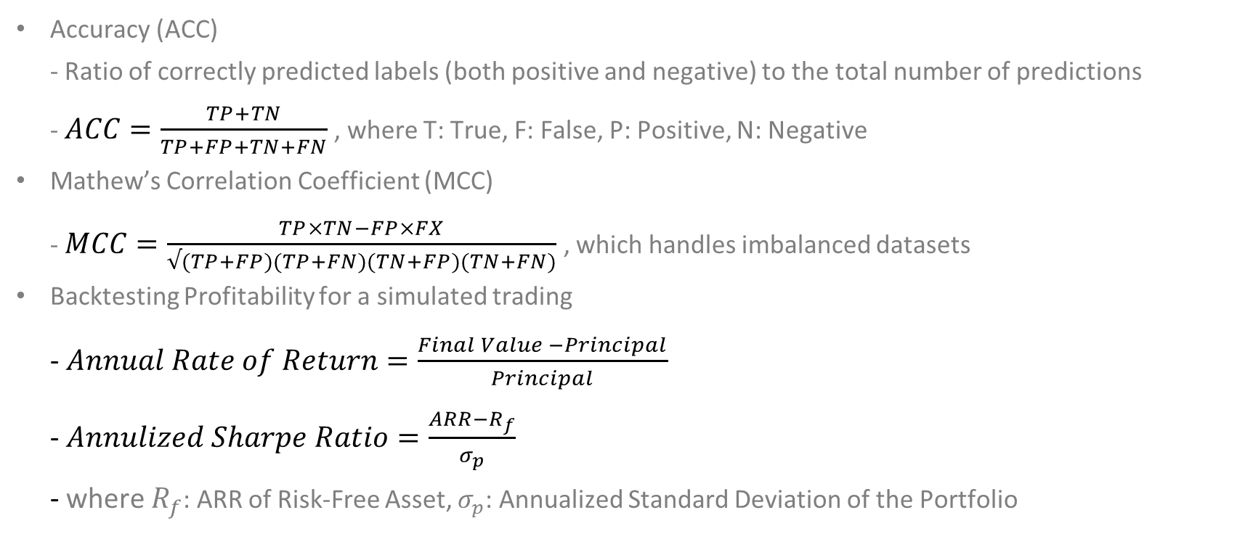
Experiments
Evaluation Setup
Evaluation Metrics
3
Accuracy (ACC) - Ratio of correctly predicted labels (both positive and negative) to the total number of predictions - $ACC=\frac{TP+TN}{TP+FP+TN+FN}$ , where T: True, F: False, P: Positive, N: Negative
Mathew’s Correlation Coefficient (MCC) - $MCC=\frac{TP×TN−FP×FX}{√(TP+FP)(TP+FN)(TN+FP)(TN+FN)}$ , which handles imbalanced datasets
Backtesting Profitability for a simulated trading - $Annual Rate of Return=\frac{Final Value −Principal}{Principal}$ - $Annulized Sharpe Ratio=\frac{ARR−R_{f}}{σ_{p}}$ - where $R_{f}$: ARR of Risk-Free Asset, $σ_{p}$: Annualized Standard Deviation of the Portfolio

Slide 26
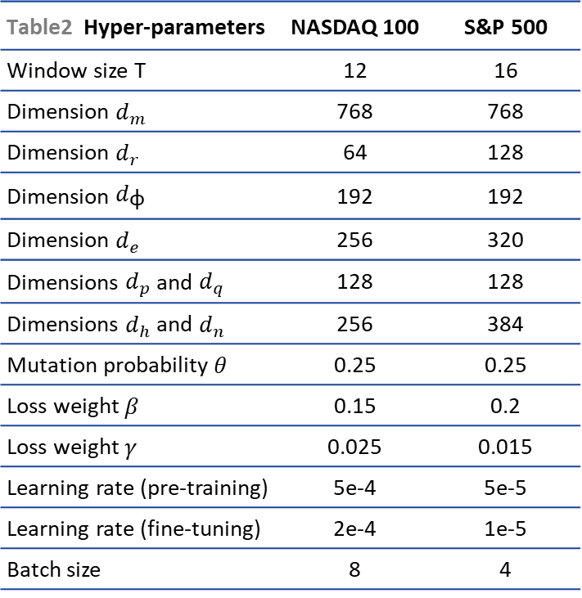
Experiments
Evaluation Setup
Implementation Details
4
Table2 Hyper-parameters | NASDAQ 100 | S&P 500
Window size T | 12 | 16
Dimension $d_{m}$ | 768 | 768
Dimension $d_{r}$ | 64 | 128
Dimension $d_{\text{φ}}$ | 192 | 192
Dimension $d_{e}$ | 256 | 320
Dimensions $d_{p}$ and $d_{q}$ | 128 | 128
Dimensions $d_{h}$ and $d_{n}$ | 256 | 384
Mutation probability $θ$ | 0.25 | 0.25
Loss weight $β$ | 0.15 | 0.2
Loss weight $γ$ | 0.025 | 0.015
Learning rate (pre-training) | 5e-4 | 5e-5
Learning rate (fine-tuning) | 2e-4 | 1e-5
Batch size | 8 | 4
Pretraning Datasets: 2014.01 ~ 2015.12 - Resampled the same day 50 times to generate 50 different activation subsets in two years
Fine-tuning Datasets: 2016.01 ~ 2019.12
Grid Search: Hyper Parameters (Table2) Optimization
For learnable parameters - Glorot Initialization, AdamW Optimizer - Maximum of 200 Epochs
Training Cost (hrs) : 4.7 for NASDAQ100, 7.9 for S&P500
Test Cost (sec) : 0.11 for NASDAQ100, 0.32 for S&P500
GPU: NVIDIA Titan V
p. 10

Slide 27
Experiments
Evaluation Setup
Trading Portfolios
5
Holding 20 stocks
Purchasing a maximum of 10 of the highest-ranked stocks, daily basis - Using movement prediction scores - Not already present in the portfolio
Selling an equivalent quantity of the lowest-ranked stocks
➡️ Control the turnover rate
Initial Account Capital: U.S. $5 million
Transaction Costs: Buying 0.05%, Selling 0.15%

Slide 28
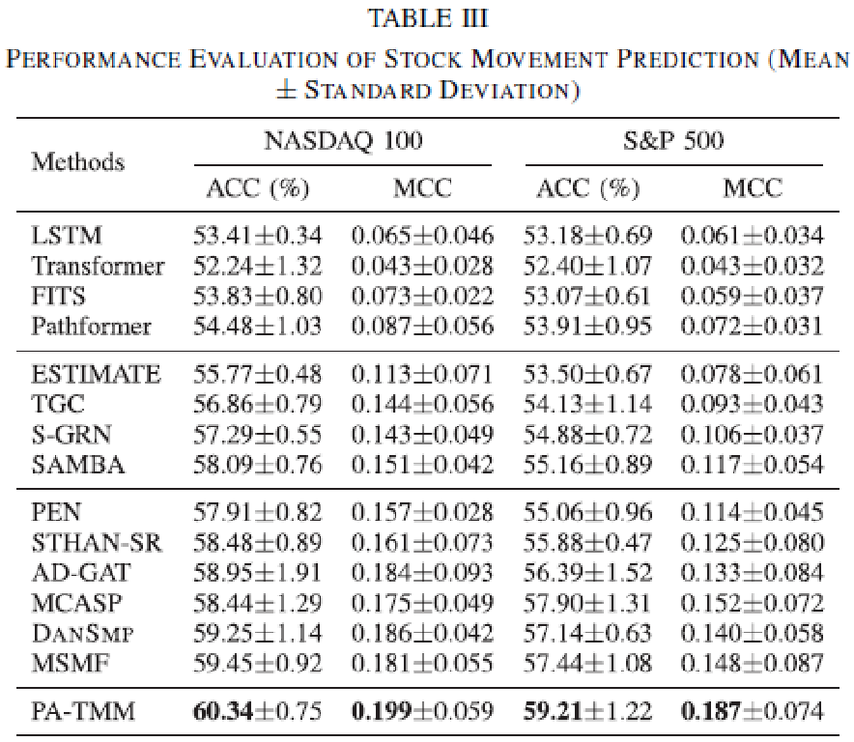
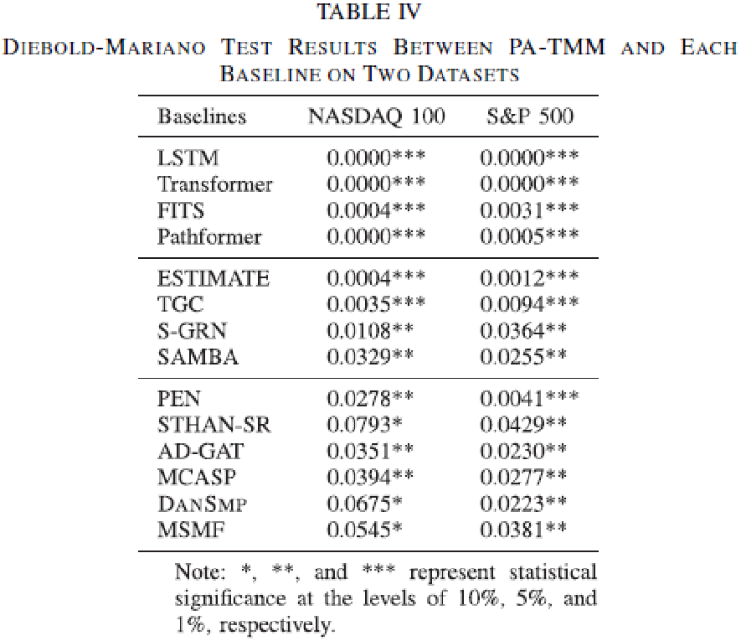
Experiments
Stock Movement Prediction
p. 10
Smaller Advantage
p. 11
Significantly Superior
Notes:
우리는 표 III에서 기존 베이스라인 모델들과 우리 PA-TMM 모델의 주가 변동 예측 결과를 보고한다. 일부 모델과 비교했을 때 PA-TMM의 성능 우위가 작게 나타나는 점을 고려하여, 우리는 추가적으로 표 IV에서 Diebold-Mariano 검정 결과를 보고한다. 이 검정의 **귀무가설(null hypothesis)**은 "두 경쟁 모델의 예측 정확도에 차이가 없다"는 것이며, 우리의 방법이 상승 움직임 예측 정확도에서 베이스라인들과 통계적으로 유의미한 차이가 있는지를 평가하기 위해 사용되었다.
그 결과, 우리 모델은 ACC와 MCC 두 지표 모두에서 모든 최신 베이스라인을 능가했으며, 두 데이터셋(NASDAQ 100과 S&P 500) 모두에서 일관된 우수한 성능을 보였다. 각 베이스라인 모델과 비교했을 때, 우리 모델은 통계적으로 유의미한 수준에서 예측 정확도가 우월함을 보였으며, 특히 NASDAQ 100 데이터셋에서는 최소 10% 유의수준 이상에서 그 차이가 검증되었다. S&P 500 데이터셋에서는 최소 5% 유의수준 이상에서 그 차이가 검증되었다.
📘 표에서 별표(*, **, ***)의 의미:
* : 10% 유의수준에서 통계적으로 유의 (p < 0.1)
** : 5% 유의수준에서 유의 (p < 0.05)
*** : 1% 유의수준에서 매우 유의 (p < 0.01)
예측 정확도가 같다는 귀무가설을 세워 이를 부정하려고 함
우연이 유사한 결과가 나올 수 있는 확률일 얼마나 낮은지를 보임으로써
얼마나 유의한지(실제로 의미가 있는 차이인지)를 증명함

Slide 29
Experiments
Stock Movement Prediction-Analysis
Time-Series Stock Prediction
Graph-Based Stock Prediction
News-Based Stock Prediction
LSTM, Transformer, FITS, and Pathformer
Ignore complex relationships among stocks
Perform worse than graph-based models
ESTIMATE, TGC, S-GRN, and SAMBA
Outperform time-series models
Ignore external news information
Constrained by efficient capital markets
Unnecessary noise information
PEN, STHAN-SR, AD-OAT, and DANSMP - Bimodal (time series, news) - Superior performance compared to nonnews methods
MCASP and MSMF - Trimodal (time series, news, and technical indicators) - Better performance on the S&P 500 dataset
Overlook the long-tailed feature distribution ➡️ Underutillize the news
PA-TMM
Optimal prediction performance in terms of both ACC and MCC
Overcome the long tail effect inherent in stock feature distribution
Notes:
우리는 표 III에서 기존 베이스라인 모델들과 우리 PA-TMM 모델의 주가 변동 예측 결과를 보고한다. 일부 모델과 비교했을 때 PA-TMM의 성능 우위가 작게 나타나는 점을 고려하여, 우리는 추가적으로 표 IV에서 Diebold-Mariano 검정 결과를 보고한다. 이 검정의 **귀무가설(null hypothesis)**은 "두 경쟁 모델의 예측 정확도에 차이가 없다"는 것이며, 우리의 방법이 상승 움직임 예측 정확도에서 베이스라인들과 통계적으로 유의미한 차이가 있는지를 평가하기 위해 사용되었다.
그 결과, 우리 모델은 ACC와 MCC 두 지표 모두에서 모든 최신 베이스라인을 능가했으며, 두 데이터셋(NASDAQ 100과 S&P 500) 모두에서 일관된 우수한 성능을 보였다. 각 베이스라인 모델과 비교했을 때, 우리 모델은 통계적으로 유의미한 수준에서 예측 정확도가 우월함을 보였으며, 특히 NASDAQ 100 데이터셋에서는 최소 10% 유의수준 이상에서 그 차이가 검증되었다. S&P 500 데이터셋에서는 최소 5% 유의수준 이상에서 그 차이가 검증되었다.
📘 표에서 별표(*, **, ***)의 의미:
* : 10% 유의수준에서 통계적으로 유의 (p < 0.1)
** : 5% 유의수준에서 유의 (p < 0.05)
*** : 1% 유의수준에서 매우 유의 (p < 0.01)
예측 정확도가 같다는 귀무가설을 세워 이를 부정하려고 함
우연이 유사한 결과가 나올 수 있는 확률일 얼마나 낮은지를 보임으로써
얼마나 유의한지(실제로 의미가 있는 차이인지)를 증명함

Slide 30
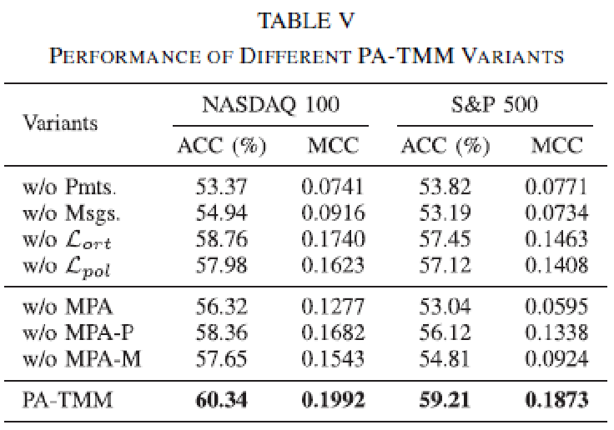
Experiments
Ablation Study
Effectiveness of the Model Architecture
Sentiment prompts and Graph aggregation mechanism - Pivotal role in addressing the long tail effect ➡️ Ensure the feasibility of implementing MPA
Modal decomposition and Polarized activation ➡️ Enhance the efficiency of utilizing news
Effectiveness of MPA
MPA: Responsive to activated nodes ➡️ Promptly capture news without over-fitting
Varying number of activated nodes ➡️ Preadapt to the real-world pattern
Mutation Strategy ➡️ Avoid over-reliance on activated nodes
p. 11

Slide 31
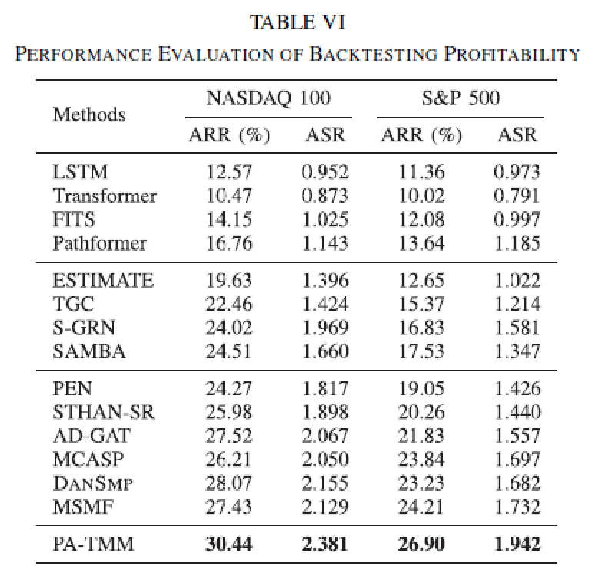
Experiments
Backtesting Profitability
Simulate real-world investment
Highest ARR Score, Highest ASR Score
Backtesting Results + Prediction Performance ➡️ The more precise, the more profitable
Performance on the S&P 500 is lower - More stocks than NASDAQ 100. ➡️ Increased complexity of risk management
News-Based Multimodal Methods - Higher ASR scores than those of GNN based methods ➡️ Better resilience to risks
PA-TMM without constraint of predefined relationships - Effectively leverage news sentiments
p. 12

Slide 32
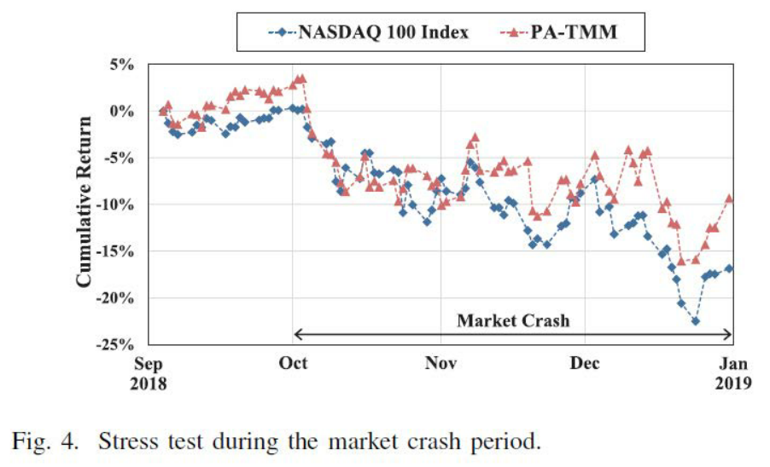
Experiments
Stress Test During Market Crash
Market Crash: 2018.10 ~ 2018.12 - The Federal Reserve persistently increased interest rate ➡️ Stock market came under pressure
Demonstrates substantial resilience in extreme market conditions - Early: Struggled to navigate the market's panic sentiment - Later: Progressively acclimated to the market conditions
Showcase an aptitude for risk management
p. 12

Slide 33
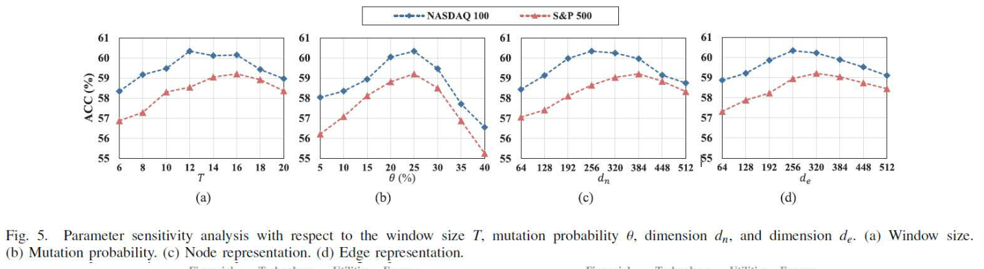
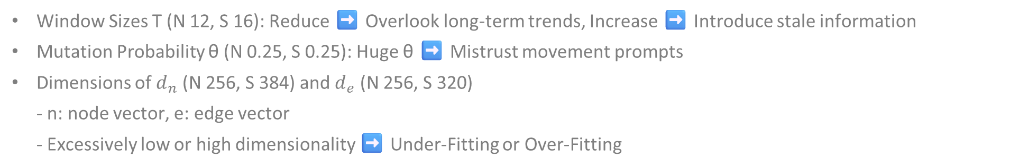
Experiments
Parameter Sensitivity Analysis
Window Sizes T (N 12, S 16): Reduce ➡️ Overlook long-term trends, Increase ➡️ Introduce stale information
Mutation Probability θ (N 0.25, S 0.25): Huge θ ➡️ Mistrust movement prompts
Dimensions of $d_{n}$ (N 256, S 384) and $d_{e}$ (N 256, S 320) - n: node vector, e: edge vector - Excessively low or high dimensionality ➡️ Under-Fitting or Over-Fitting
p. 13

Slide 34
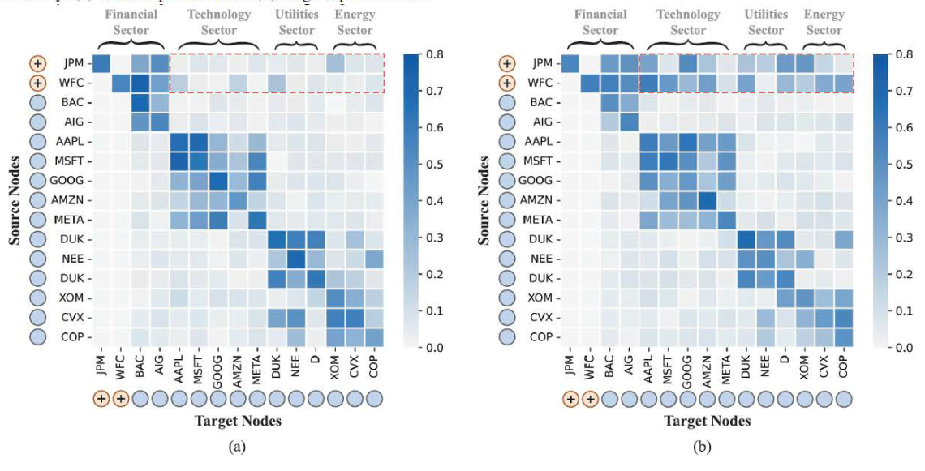
Experiments
Case Study on Exploring Stock Attention Networks
On April 12, 2019, investigate the effectiveness of MPA with S&P500 dataset - News: Strong earnings reports from JPM and WFC ➡️ Broadly positive market sentiment and Strong bullish signals
Without MPA - Independently distributed attention - Limited attention to the news from other stocks
With MPA - Significant increase in cross-sector attention
Fig. 6
(a): Without pretraining (w/o MPA)
(b): After pretraining (PA-TMM)
p. 13

Slide 35
Conclusion
PA-TMM - Novel model for stock movement prediction and quantitative trading - Address the long-tail distribution problem - MPA (pretraining) + EQSamp (data augmentation) ➡️ Enhance sensitivity to news - Leverage news sentiment as prompts ➡️ Capture cross-modal signals more effectively
Experimental results - Superior prediction performance in terms of ACC and MCC - Various comparative studies validate effectiveness, profitability, and robustness
Future work - Explore lightweight attention mechanisms - Integrate other textual sources like financial reports, social media, geopolitical events, and regulations for to enhance the models’ understanding of stock market and prediction accuracy

Slide 36
End of Documents

